Slide 1
Building Effective Council-Staff Relationships: Establishing and Maintaining Proper Roles and Responsibilities
WVML Conference
August 6, 2009

Slide 2
Today’s Session
Introduction
Roles and Responsibilities
The Governance Process
The Issue of Politics
Leadership and Teamwork
Accountability

Slide 3
My Background
20+ yrs in public management
Five jurisdictions
Worked for four City Councils and a Regional Council
Thousands of public meetings
Worked with hundreds of elected and appointed officials
Started when I was very young

Slide 4
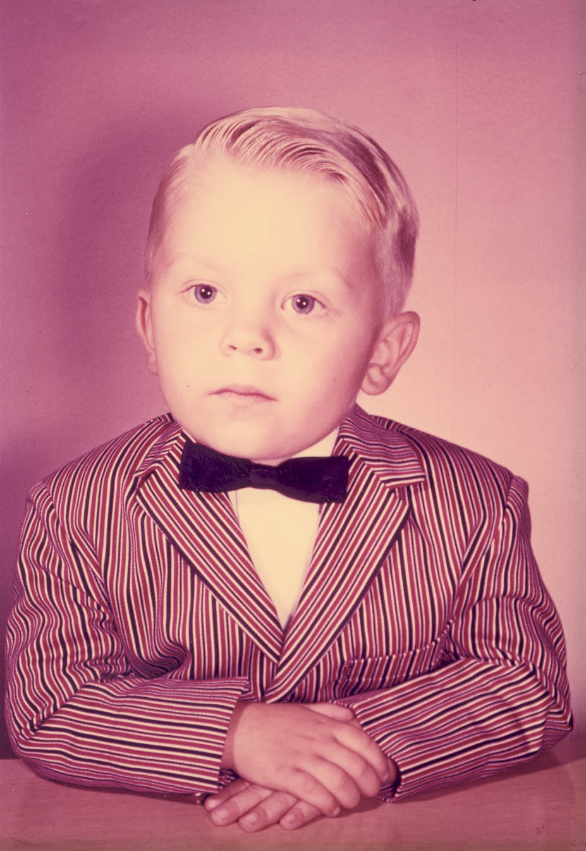
Craig R. Rapp
City Manager

Slide 5
Sometimes the meetings got a little lively…

Slide 6


Slide 7
“The secret to managing is to keep the guys who hate you away from those who are undecided”
-Casey Stengel

Slide 8
Roles and Responsibilities
Council/Board
  Legal Roles
  Traditional Roles
  Ad hoc Roles
  Imaginary Roles
Chief Administrator Role
Staff Role

Slide 9
Legal Roles
Described in your charter, ordinances and by-laws
  Elected representative
  Public Policymaker/Legislator
Issues
  Citizen representation approach
  Policy/ordinance creation and adoption process
  Process of identifying problems, new directions, raising issues

Slide 10
Traditional Roles
Accepted roles, by common practice or tradition
  Community Representative
  Politician
Issues
  Context of roles
  Public perception
  Individual vs. group

Slide 11
Ad hoc Roles
Roles you assume to “get the job done”
  Visionary
  Change agent
  Role Model
Issues
  Appropriateness
  How to use these roles productively

Slide 12
Imaginary Roles
Roles you “slip into” by accident, or design
  City Administrator
  City Engineer
  City Attorney, etc…
  Voice of the City
Issues
  Staff/Board conflict
  Competition/confusion

Slide 13
City Administrator Role
Defined in ordinance/law
  Staff Leader
  Support to Council
  Producer of Results
  Change agent
  Motivator
  Role Model
  Political Filter/Synthesizer

Slide 14
Staff Role
Department Operations
Support to Committees/Board
Basic service delivery
Carry out directives of Board and Administrator

Slide 15
Maintaining Proper Roles
Agreeing on the definitions
Staying within the boundaries
Accountability for actions

Slide 16
The Governance Process
What is it?
Can you define it?
What if we disagree?
A common understanding

Slide 17
The Governance Process
How things get done
Division of responsibilities and accountabilities between Council and staff
Carver Model for Policy Governance (best practice)
    Ends
    Executive Limitations
    Board-Staff Linkage
    Governance Process

Slide 18
Ends
The Board defines which needs are to be met, for whom, and at what cost.

Slide 19
Executive Limitations
The Board establishes the boundaries around which methods and activities can responsibly be left to staff.
These limits apply to staff means, or how things get done, rather than ends, or the outcomes.

Slide 20
Board-Staff Linkage
The Board clarifies the manner in which it delegates authority to staff; it also evaluates staff performance based upon executive limitations, policies, and provision of the ends (outcomes).

Slide 21
Governance Process
The Board determines its philosophy, its accountability, and specifics of its own job.
The effective design of board processes ensures it will fulfill three primary responsibilities:
  maintaining links to the citizenry,
  establishing the four categories of written policies,
  assuring executive performance.

Slide 22
Carver Principles
The trust in trusteeship (govern on behalf of citizens)
The Board speaks with one voice or not at all
Board decisions should predominantly be policy decisions
Boards should formulate policy by determining broadest values before progressing to more narrow ones
A board should define and delegate rather than react and ratify

Slide 23
Carver Principles
6. Ends determination is the pivotal duty of governance
7. The Board’s best control over staff means is to limit, not prescribe
8. A Board must explicitly design its own products and processes
9. A Board must forge a linkage with management that is both empowering and safe
10. Performance of the CEO must be monitored rigorously, but only against policy criteria

Slide 24
The Challenge – Dealing with Politics

Slide 25
Organizational Politics
Think you understand it?
Think you’re good at playing the game?
Is it a game?
Are there rules?
What if you’re playing by the wrong set of rules?

Slide 26
Organizational Politics
What is your “political aptitude?”
What does it mean to be politically astute?
Personal Integrity
Organizational survival
Where is the line you will not cross?

Slide 27
The Real world of Tough Politics
Understanding the difference between tough politics and truly dysfunctional governance

Slide 28
Tough Politics
Characterized by Rules – explicit or implicit – but understood by all
Relies on political process – wins by “having the votes”
Can be emotional – but is not personal – respect remains intact
Playing to win – pushing exclusive agenda, freezing out other side…

Slide 29
Tough Politics
Maximizes political advantage – programs, personal profile, reelection
Predictability, consistency, reliability
Things get done

Slide 30
Dysfunctional
Lack of Respect
Lack of Trust
No Rules
Unpredictable, Unstable
Lack of Progress / No Progress

Slide 31
Dysfunctional
Not Making Decisions Efficiently-or at All
Not Setting or Following Goals/Priorities
Board members don’t trust each other & disrespectful to each other
Staff attacked / not trusted by Board faction
Board not respectful to and distrustful of staff

Slide 32
Summary
Tough
Respect/Trust
Political Process
Rules
Reliable
Accomplishments
Play to Win
Dysfunctional
Disrespect/Distrust
Disruption/Attacks
Chaos
Unpredictable
No Decisions
Play to Harm

Slide 34
Leadership and Teamwork

Slide 35
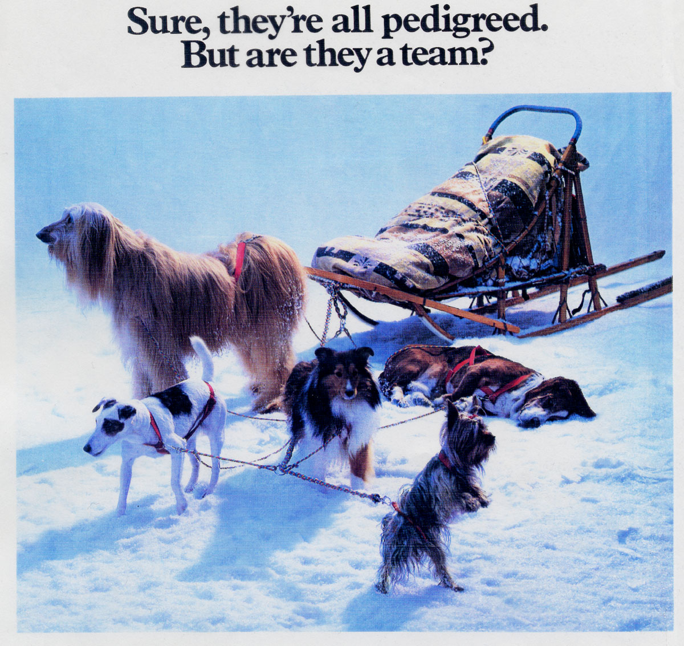

Slide 36
The Leader’s Job
To create “win/win” outcomes for your community without compromising your personal or professional ethics.

Slide 37
Leadership Traits
Courage
Decisiveness
Integrity
Unselfishness
Judgment
Initiative
Reliability
Tact

Slide 38
Leadership Traits
Think about these in connection with your responsibilities as a public official
Ask yourself how you compare, and how these traits bear upon your decision making and when you find yourself in difficult situations

Slide 39
“It’s easy to get the players.
Gettin’ them to play together, that’s the hard part.”
- Casey Stengel

Slide 40
Leadership Team
Mayor/Board and Administrator are a team
Role definition is crucial
Majority/minority bloc – Administrator response
The role of political leadership can become “slippery” without clear rules and accountability

Slide 41
Teamwork – we have met the enemy, and they is us!
What is it?
How do you get it?
Does it matter?
Can’t we just vote?

Slide 42
Teamwork
What is it?
  Working together to achieve common goal
  Collaborating to expand the capacity and effort of the group
  A focused effort based upon shared vision, values, goals and congruent policies

Slide 43
Teamwork
How do you get it?
  Start by wanting it
  Identify/agree on its value (greater than sum of parts)
  Define shared vision, values, goals
  Create the atmosphere for success
  Act in accordance with values/beliefs
  Establish accountability

Slide 44
The Role of the Individual
The Role of the Group

Slide 45
Individuals and the Group come together due to of alignment of:
Values
Behaviors
Accountability

Slide 46
Definition Of Values:
Deeply held set of beliefs about the way the world should work
Values Govern and Guide Our Behavior In:
Our Interactions with Board members
Our Relationships with Citizens
Our Commitment to Excellence
Our Relationships with Others

Slide 47
Forming Shared Values
Causes People To …
Build Trust with Each Other
Be More Willing to Take Risk
Be more Open to New Alternatives
Be More Open to Learning and Growing
Feel a Greater Sense of Commitment
Feel Empowered

Slide 48
Behaviors That Result In
Building Shared Values
Discuss and Define
Document
Display
Demonstrate
Demand Accountability
Critique

Slide 49
Values
Honesty
  We will act truthfully in the performance of our duties and in our interactions with others
Best for the City
  Our decisions and performance will be guided first and foremost by what is best for the City
Staff Expertise
  We value a highly skilled and knowledgeable workforce

Slide 50
Values
Creativity
  Creativity, imagination and originality are valued in all of our activities
Effective Problem Solving
  We are committed to solving problems in the most effective manner possible
Respectful Conduct
  We will show consideration and appreciation for the opinions and actions of others.

Slide 51
Next Steps
Where do you want to go?
How will you know when you get there?

Slide 52
Going where?
Better informed decisions?
Mutual respect?
Improved meetings?
Other?
List…
How will we follow through?

Slide 53
How will we know we’re there?
What measures can we use?
If we measure, against what?
Do we have to be happy?

Slide 54
Go Forth and Do Good Work!

